Slide 1
Secure Data Hiding In Images Using Steganography
CAPSTONE PROJECT
Presented By: Raunak Jain
Student Name : Raunak Jain
College Name & Department : Techno India NJR Institute of Technology/ Computer Science & Engineering

Slide 2
OUTLINE
Problem Statement
Technology used
Wow factor
End users
Result
Conclusion
Git-hub Link
Future scope

Slide 3
Problem Statement
In the digital era, safeguarding data security and privacy is crucial. Conventional encryption techniques are often vulnerable to detection and interception. Our project addresses this issue by utilizing steganography to conceal secret messages within images. This approach provides a discreet communication channel, strengthening data confidentiality while minimizing the risk of suspicion

Slide 4
Technology used
1. Programming Language
Python: The script is written in Python, a popular language for image processing and cryptography.
2. Libraries Used
OpenCV (cv2):
Used for loading, modifying, and saving images.
Functions used:
cv2.imread("image.jpg") → Reads an image.
cv2.imwrite("encryptedImage.jpg", img) → Saves an image after modification.
OS
Used for system-level operations like opening the encrypted image.
Functions used:
os.system("start encryptedImage.jpg") → Opens the saved encrypted image.
3.Python Version:
Works with Python 3.x.
4.Additional Technologies (Concepts)
Image Steganography: Hiding text messages inside pixel values.
Basic Cryptography: Using a passcode for authentication.
Data Encoding: Mapping characters to their ASCII values for storage in pixel channels.

Slide 5
Wow factors
Unique Features of This Image Steganography Project
Lightweight & Simple – Uses minimal libraries (OpenCV, OS) for easy implementation.
Pixel-Based Encoding – Directly embeds ASCII characters into image pixels.
Password Authentication – Ensures secure decryption with a two-step passcode.
No Visible Alteration – Hides text without distorting the image.
Cross-Platform Potential – Works on Windows, easily adaptable for Linux/macOS.
Self-Contained – No need for external key files, relying only on the passcode.
Customizable & Extendable – Can integrate encryption (AES), larger text support, or GUI.

Slide 6
End users
End Users of This Image Steganography Project
Cybersecurity Enthusiasts – Learning about steganography and secure data hiding.
Privacy-Conscious Individuals – Hiding sensitive messages within images for personal security.
Forensic Experts & Investigators – Using steganography for covert communication or digital forensics.
Journalists & Activists – Protecting sensitive information in restrictive environments.
Developers & Researchers – Enhancing and integrating steganography with encryption techniques.
Students & Educators – Understanding image processing, cryptography, and data security.

Slide 7
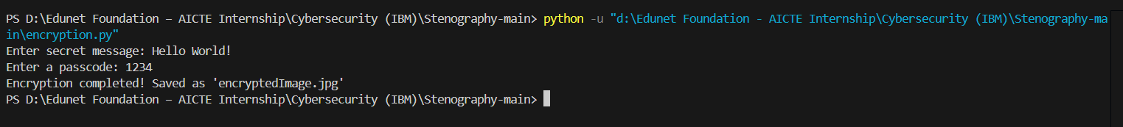


Results
Encrypted Image

Slide 8
Conclusion
This Image Steganography project effectively addresses the problem of secure and
hidden communication by embedding secret messages within images.
By leveraging OpenCV for image processing and Python for encryption, the project
ensures confidentiality while maintaining the original appearance of the image.
The dual-layer security with password protection enhances data safety, making it useful
for cybersecurity, privacy protection, and secure data exchange.

Slide 9
GitHub Link
https://github.com/Raunak-edunet/Secure-Data-Hiding-In-Images-Using-Steganography.git

Slide 10
Future scope(optional)
Enable support for multiple image formats and high-resolution images.
Expand the technique to video steganography for dynamic data concealment.
Integrate advanced encryption algorithms to enhance message security.
Develop a web-based or mobile application for wider accessibility.
Implement automated tools for detecting and extracting steganographic content.

Slide 11
THANK YOU

